Slide 1
Advanced data science IBM Capstone project
Muhammad Abdur Rehman Khan

Slide 2
Business Problem
Case
Energy Consumption in Netherland, an open case
Context
In Netherland, the three companies are responsible for providing energy in terms of electricity and gas to the whole country. The three companies are Enexis, Liander and Stedin. Every company has shared data of ten years from 2009 to 2018. The data is splitted into two categories, Electricity and Gas. Each year data is comprised of twelve features. Among features, five are providing statistical information.
Objective
Total Energy consumption in 2019

Slide 3
Architectural Decision
Architectural Choices
IBM & Kaggle Cloud
Data Source & Initial Data Exploration
The three companies data are available in csv format. There are almost twenty csv files of each company, showing electricity and gas data.
Extract Transform and Load, ETL
ETL is an import tool to convert data into readable format. There are three phases. In first phase, we will extract each company's data. In other two phases, we will first merge the data according to our requirements and then load the data frame. We will make three data frames, one for electricity data, the other for gas data and the last one consisting of all the data.

Slide 4
Architectural Decision
Feature Creation
We have tried two different methods to design our model to predict Annual Consumption, the target variable. First, we have selected our features, ‘delivery_perc’, ‘annual_consume_lowtarif_perc’, smartmeter_perc’ and ‘type_connn_perc’, and correlated with the target variable ‘annual_consume’.
Correlation Information
The correlation is very weak among the features, so it won't work to train the model.
Feature Engineering
Now its time for feature engineering. We have created a new feature called ‘year’ against the ‘annual_consume’ This created variable will give every year information which will be suitable for model designing. Now we will design our model against this feature.

Slide 5
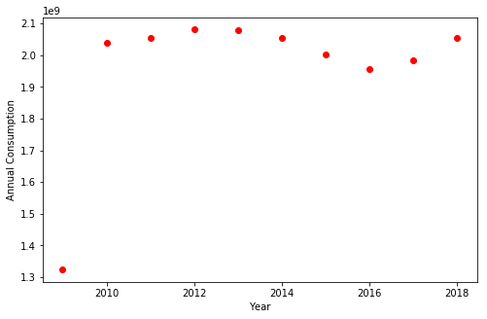
MOdel
Model Definition
After visualizing the feature ‘year’ against the predicting variable. It is obvious that the trend is non linear and the shape is Logarithmic. We have to go for machine learning nonlinear regression algorithm.

Slide 6
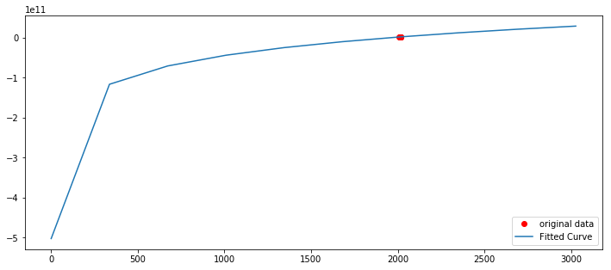
MODEL
Model Algorithm
As the data shape is nonlinear and the trend is showing Logarithmic. We have created a function with two parameters for controlling the curve steepness and slides the curve on the x-axis. Through SciPy optimize function curve fit, we found the value of the parameters. From the image , the fitted curve response is excellent.

Slide 7
MODEL
Model Training
After building the algorithm , we train the model with the training set and the testing is done with the test set. Normalization is must before training the data, otherwise the evaluation will be not be appropriate.
MODEL EVALUATION
We have applied different tests to calculate Mean Absolute Error (MAE) and Mean Squared Error for error (MSE). For accuracy, we have applied coefficient of determination, R2-score.
The results are amazing. R2 score is 1, while MAE and MSE is zero.

